Slide 1






PocketPaw Co: Environment
YOUR PET IN YOUR POCKET

Slide 2
Our team
David Pérez
Federico
Falcone
Guillem
Escriba
Oriol Soler
CEO
CFO
CEO
GENERAL MANAGER
Data Science Engineer
Computer Engineer
Data Science Engineer
Audiovisual Engineer

Slide 3





Sector attractiveness analysis:
CUSTOMERS
SUPPLIERS
Debilidades
Growing market: 29 million pets in Spain
Most are not informed about these tools
Easy to switch apps.
High amount of suppliers
Easy change of suppliers
COMPETITORS
A lot of competitors
No big competitor
Differentiation
Easy entry to the market
Low investment
Established competitors
Replacable features
Unique as a whole
NEW COMPETITORS
SUBSTITUTES

Slide 4
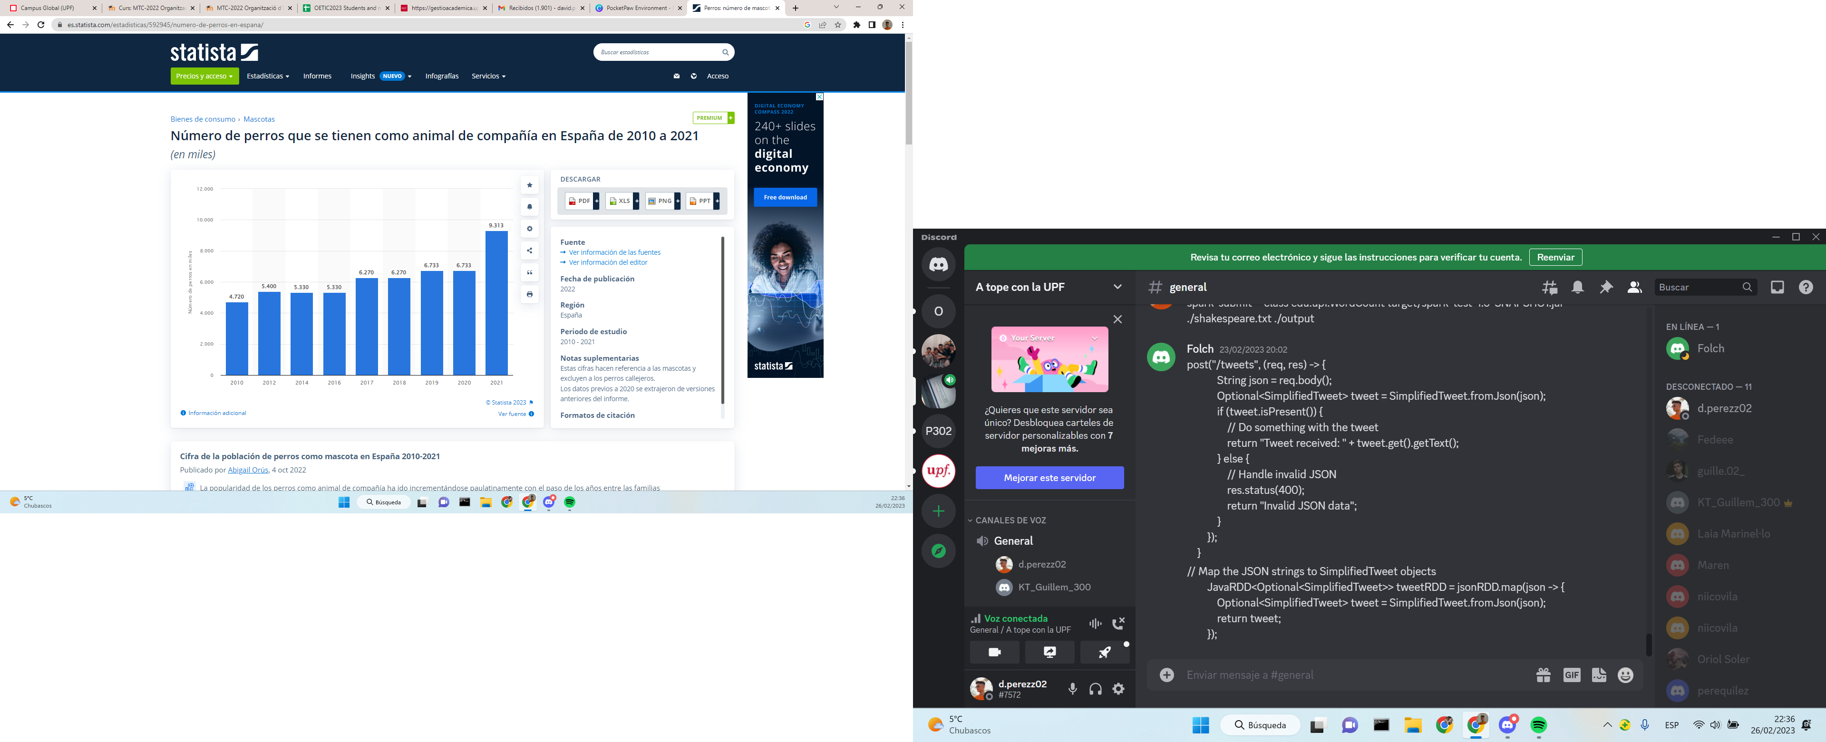
Pet Care Sector in Data:
Number of dogs (in thousands)
Moderate growing year by year.
Abrupt increase after Pandemic and lockdown.
-> Post pandemic lives adopted a house
lifestyle, which lead to adopting
more pets.
-> So many traditions from Pandemic
have come to stay. Telecommuting,
online affairs... increase the need of
an animal friend in home.
Year
NEW COMPETITORS
SUBSTITUTES

Slide 5
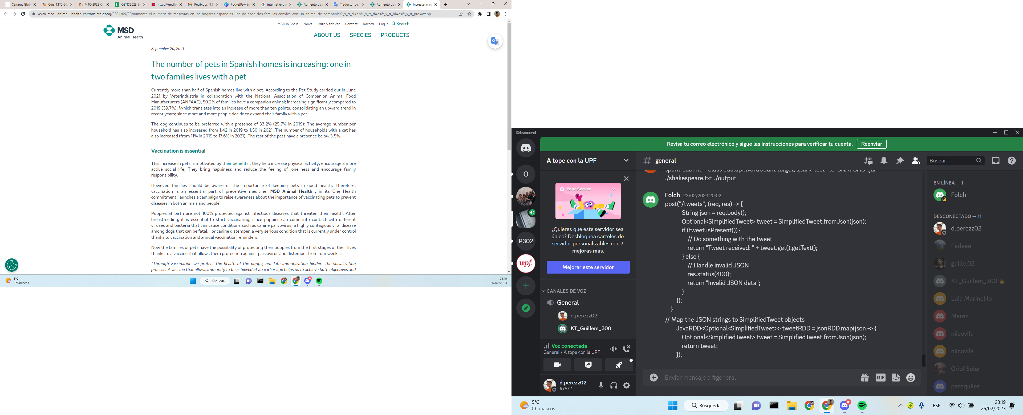
Pet Care Sector in Data:
Half of Spanish households have pets, according to MSD Animal Health.

Slide 6
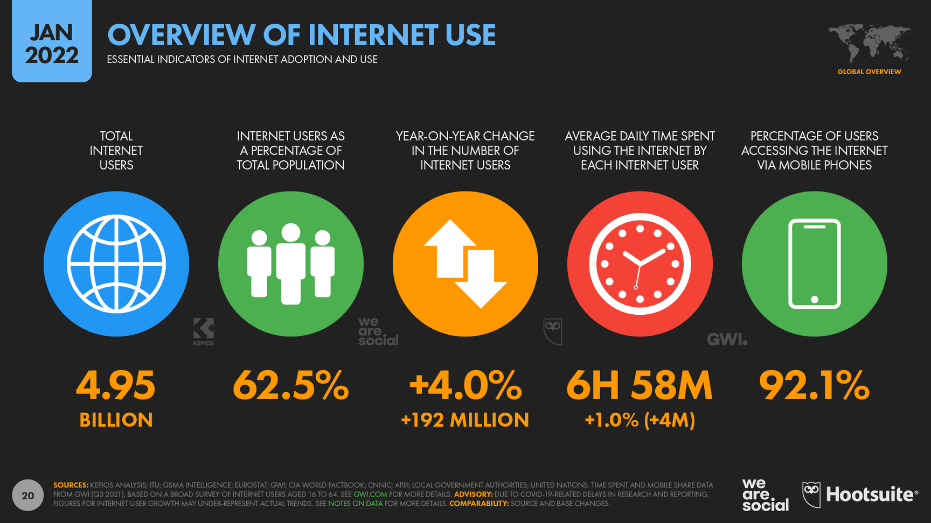
Pet Care Sector in Data:
More internet engagement trough years leads to more potential users.
Common internet and apps users see with better eyes new apps about monitoring the data of their belongings, like PocketPaw.
NEW COMPETITORS
SUBSTITUTES

Slide 7




SECTOR ATTRACTIVENESS:
COMPETITORS - RIVALRY
So many small competitors.
So many competitors of our GPS offer.
Competitive pricing.
Competitive advantage:
-> Kiwoko distribution,
-> All features from competitors in one app + unique features.
Differentiation:
Differentiation:
Differentiation:
11pets - All-in-One
Puppr - Best Training
Rover - Dog sitters
500.000
1.000.000
100.000
Competitive Advantage: Lower price
Competitive Advantage: Specialized service
Competitive Advantage: Biggest market share
MARKET SHARE:
11pets - Annual Revenue in 2022: $1.0M - $2.0M
Rover - Annual Revenue in 2022: $0.16 B

Slide 8


SECTOR ATTRACTIVENESS:
CUSTOMERS - NEGOTATION
Market with high volume and still growing.
High customer leverage: No barriers to switch apps.
Better customer leverage with PRO version: tracker GPS
There is a great oportunity in this sector but it's key to find customers loyalty.
50%
spanish homes with pets
5%
people use an app after 1 month

Slide 9

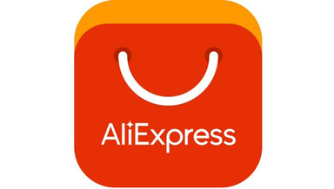

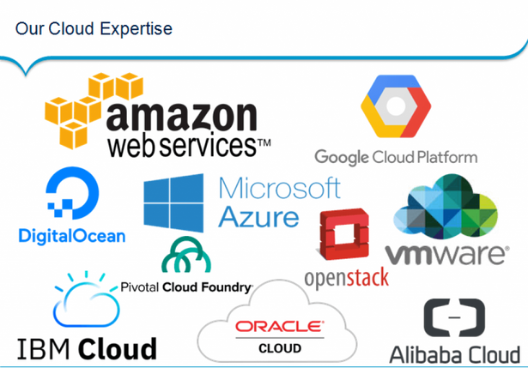


SECTOR ATTRACTIVENESS:
SUPPLIERS - NEGOTIATION
There are several GPS manufacturers around the world.
Very competitive pricing, as low as 6$.
Easy to change between suppliers.
High amount of server providers and hosting.
Even if is easy to change between hosting providers we plan to have a long-term contract with them to reduce expenses.
Suppliers have a low negotiation capacity.
Usage of virtual stores such as Google Play or AppStore to provide download facilities of our app. Increments a little negotiation leverage.
We would advertise the app in Google Ads and Social Media like Instagram and Facebook.

Slide 10
SECTOR ATRACTIVENESS:
NEW COMPETITORS
It is a growing industry with high demand.
The entry barrier is very low for new competitors. For a initial development and maintenance of a similar service it is estimated an initial investment of 35.000$.
Main difficulty to design a transcendental app with only functional and useful features.
There are some well established competitors that make hard to gain a market share.
In order to let new competitors aside the market we can negotiate with other big players such as Rover.

Slide 11
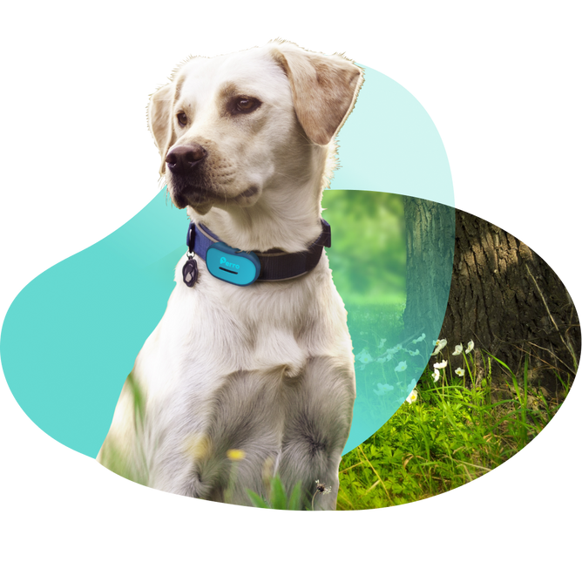
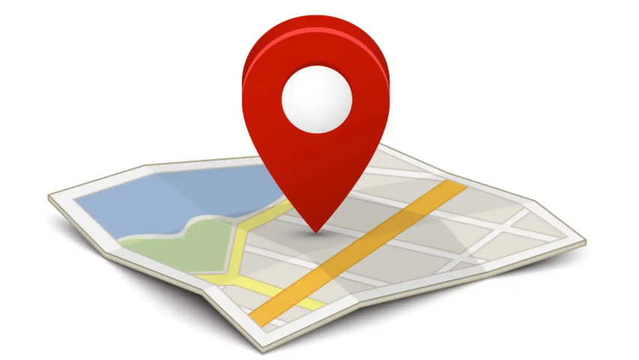
SECTOR ATRACTIVENESS:
SUBSTITUTE PRODUCTS
We offer a unique value proposition by combining the most useful pet services.
Social media platform value.
Powerful collaboration with KIWOKO.
Some features can be easily individually substituted.
-> Traditional methods
-> Cheap GPS everywhere

Slide 12
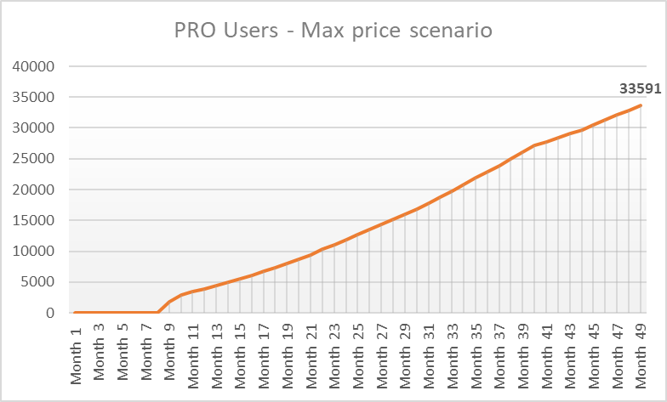
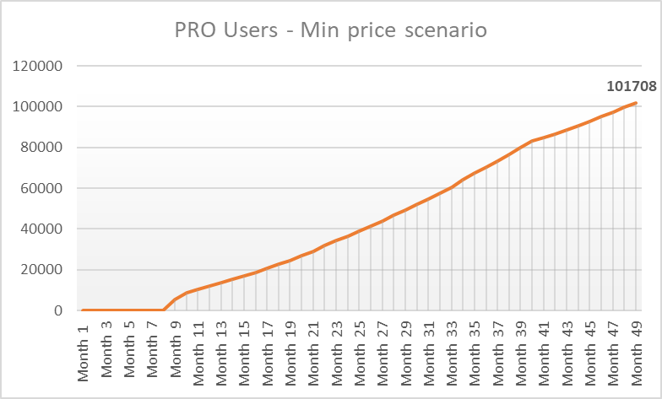
SCENARIOS: Price Variation

Slide 13
SECTOR ATTRACTIVENESS
COMPETITORS - RIVALRY:
CUSTOMERS - NEGOTIATION LEVERAGE:
SUPPLIERS - NEGOTIATION LEVERAGE:
NEW COMPETITORS:
SUBSTITUTE PRODUCTS:
SECTOR ATTRACTIVENESS:
Notes:
In conclusion, the pet care and GPS tracker market is an attractive market with high demand and potential for growth. However, our business will face competition and several barriers to entry. By analyzing the five forces, we have identified the potential challenges and developed strategies to overcome them, pushing our business to succeed in the market.

Slide 14
Techology insertion in pet care
Bring people closer to their pets
Help people with their first pets
High influence of tracking technology in global economy.
Support useful investment in pet care.
SOCIO-CULTURAL
ECONOMIC
All the data about your pet in your phone.
Thanks to huge social media we provide a greater common knowledge.
Protect the users privacy.
Follow EU general data protection regulation
Enforce the animal care law enforcement
LEGAL
TECHNOLOGICAL

Slide 15

Value pyramid
By monitoring their activities and health, owners enhances their emotional bond between them and their pets, and promotes a sense of responsibility and commitment towards them
Social
Collecting sensitive personal data such as location and health information is one of the most critical legal value. We must comply with relevant privacy laws such as the GDPR and implement appropriate security measures to safeguard user data
Protection
Providing easy accessibility of pet data through a mobile app can save pet owners time and effort, while the platform can facilitate the sharing of knowledge and experiences related to pet care, enabling pet owners to learn from one another
Technology
The app represents an investment in this growing market, providing a valuable tool that can help pet owners to better care for their pets and promote responsible pet ownership
Economic & Pricing

Slide 16



Internal
External
S
W
O
T
Strength
Weakness
Recurring revenue
Dependence on technology
Integration with other pet-related services
Crowded market
Scalability
Limited target

Slide 17


Internal
External
S
W
O
T
Opportunities
Threats
Expansion into new markets
Technological advancements
Development of new features
Economic downturn
Building a community
Legal and regulatory issues

Slide 18


Thanks for your participation!
EMAIL | WEBSITE | SOCIALS
info@pocketpaw.com | www.pocketpaw.com | @pocketpaw

Slide 19
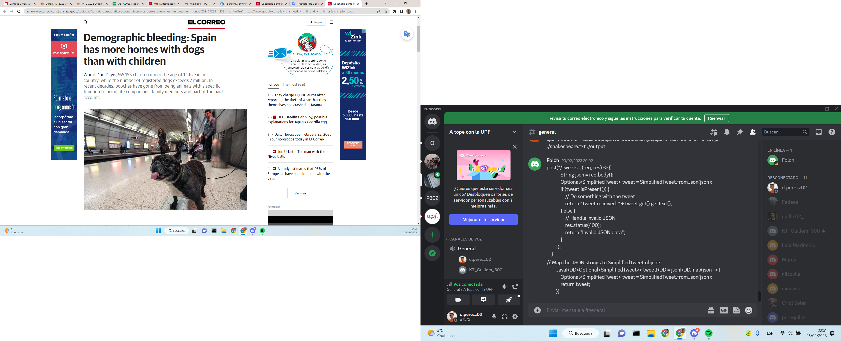
BACK UP SLIDES
New spanish lifestyle: Adults prefer pets rather than children.
All of this helps the faster growing of the market in the post-pandemic years.
Spanish newspaper - EL CORREO, July 2021

Slide 20
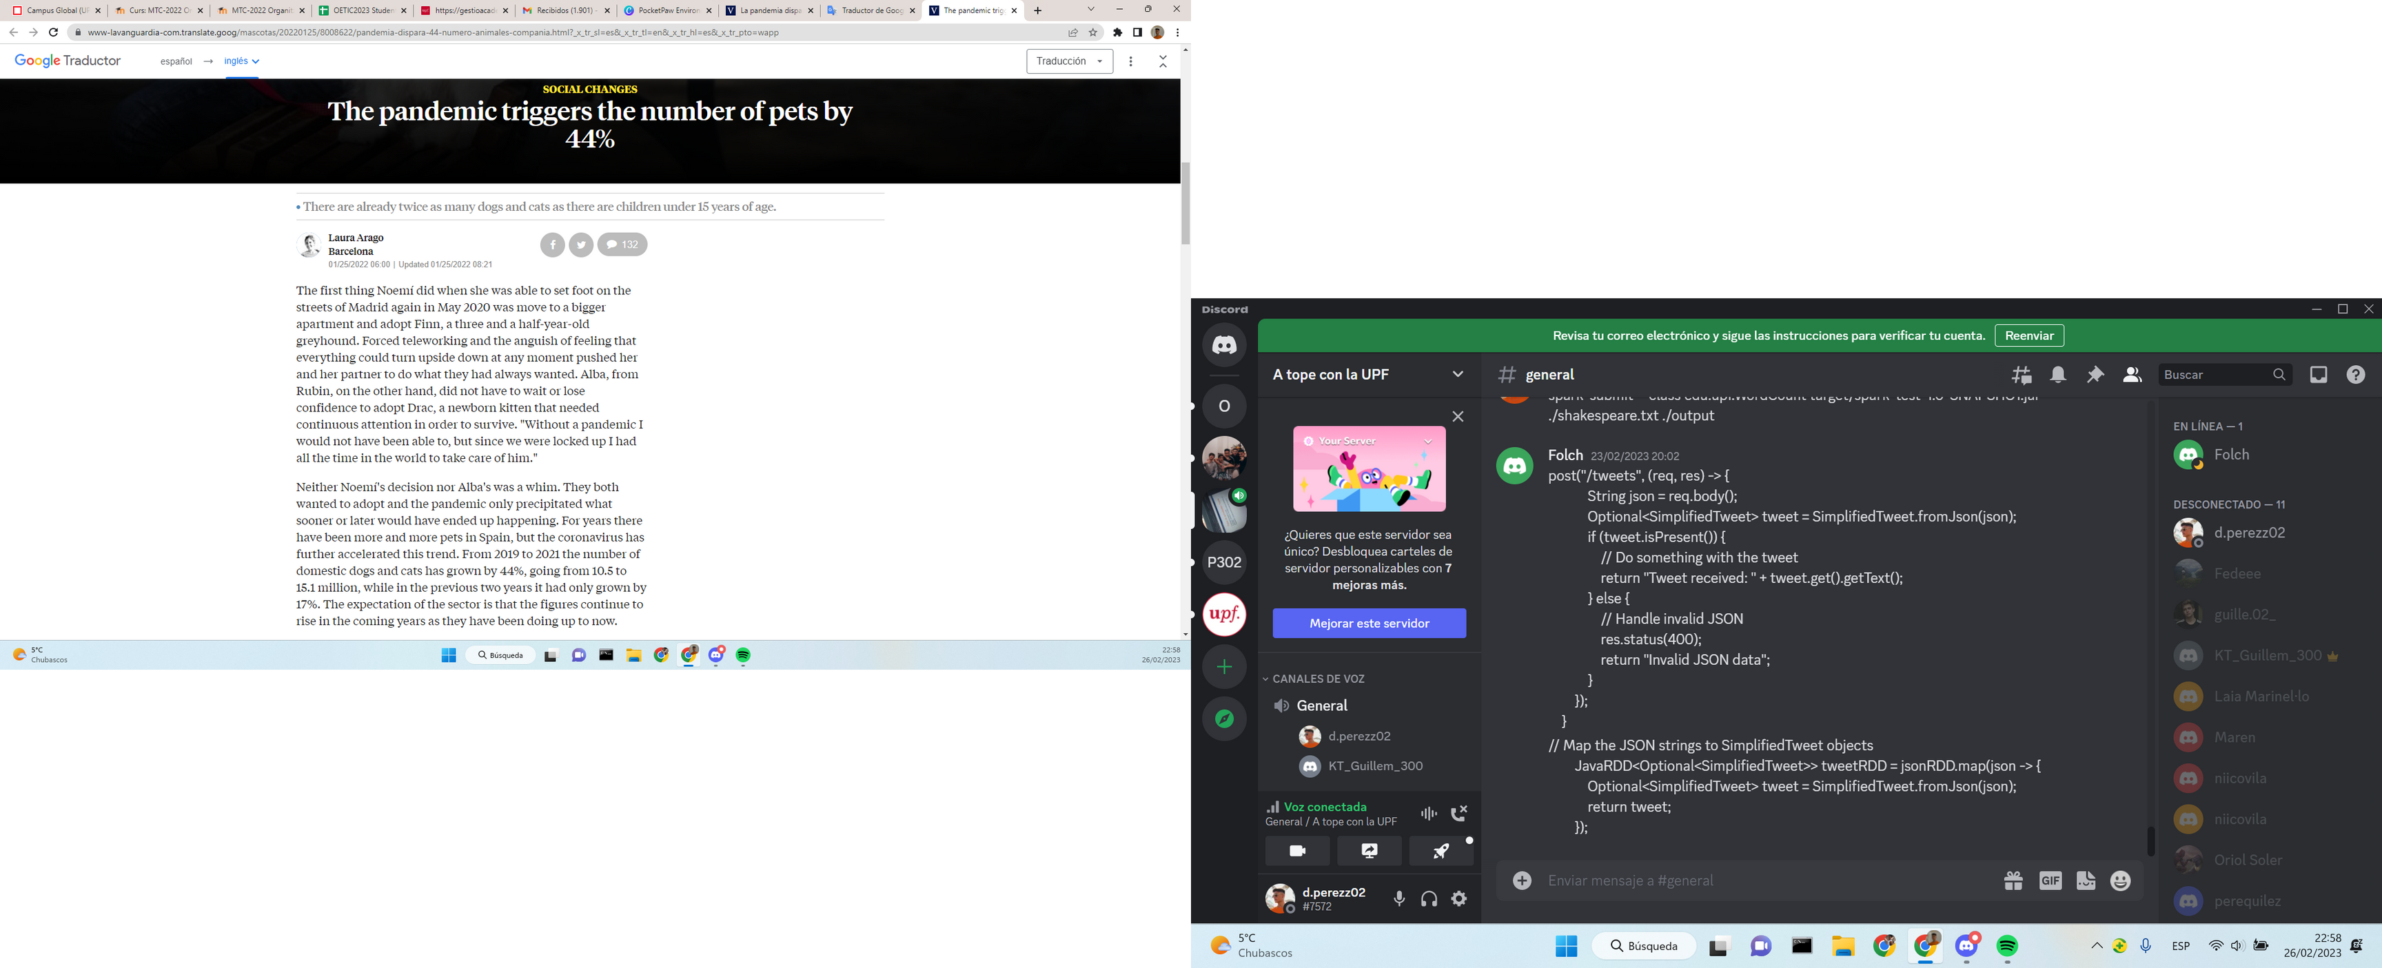
BACK UP SLIDES: The Pandemic effect
More data about the pandemic effect on the spanish people tendency about pets, now from La Vanguardia, one of the most important newspapers in Spain.
After the pandemic, the number of pets increased by 44%. After, not only during, since it lead to a new lifestyle closer to home, and this is still present in the most part of the society.
Spanish newspaper - LA VANGUARDIA, January 2022

